Slide 1
CSC 374/407: Computer Systems II
Lecture 3
Joseph Phillips
De Paul University
2014 January 3
Copyright © 2011 Joseph Phillips
All rights reserved

Slide 2


Reading
Bryant & O'Hallaron “Computer Systems, 2nd Ed.”
  Chapter 8: Exception Control Flow
Hoover “System Programming”
  System Calls 7.1-7.4

Slide 3
Topics
Processes 1
Exceptions
  Interrupts
  Trap
  Fault
  Abort
Processes 2
  Process lifecycle
  fork() and getpid()
  exit() and atexit()
  execlp()
  wait(), waitpid()
  Zombies

Slide 4
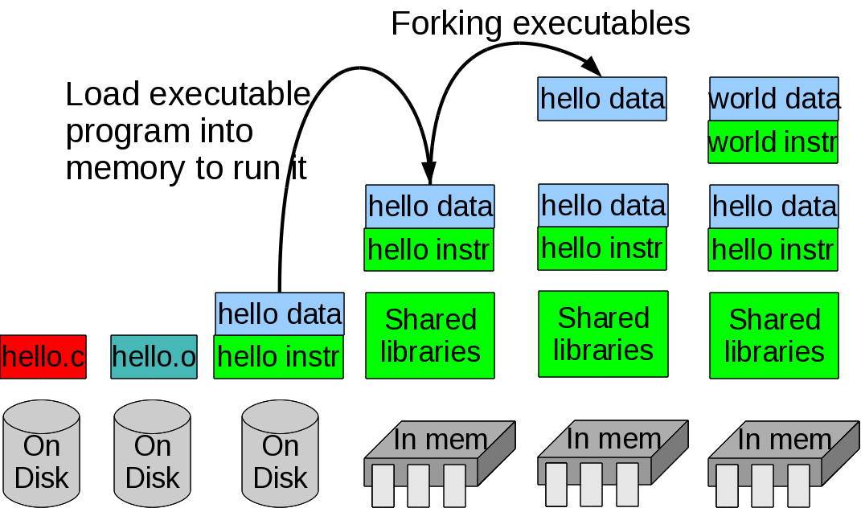
Today's topic (in time)
Running executable files and forking

Slide 5
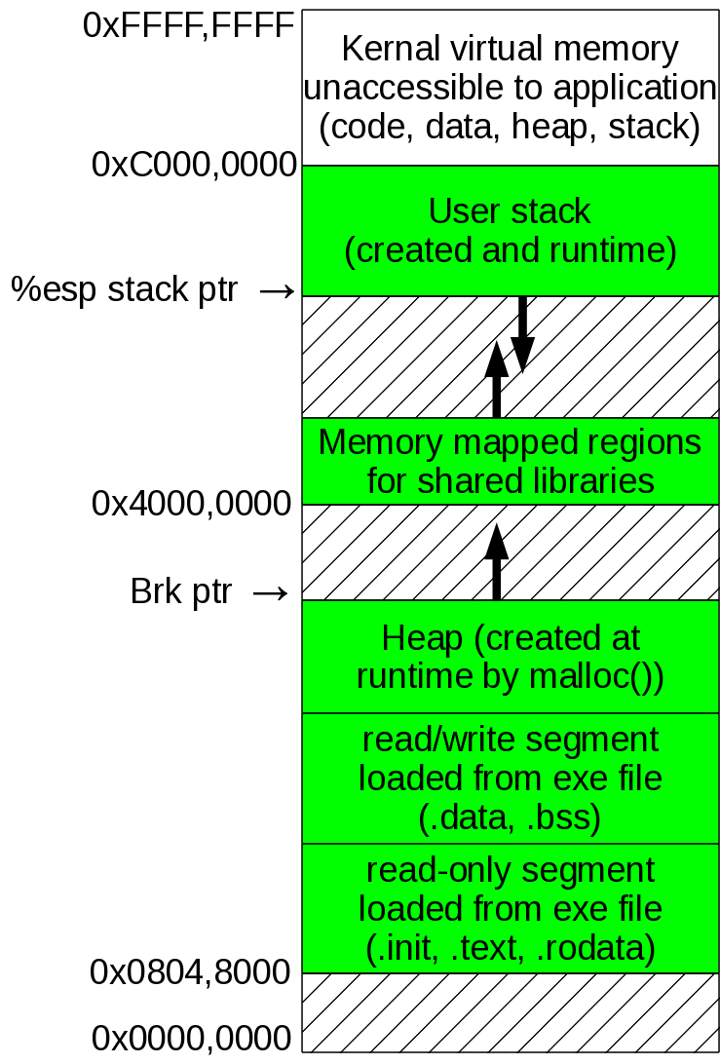
Today's topic (in space)
Loading or setting up everything:

Slide 6
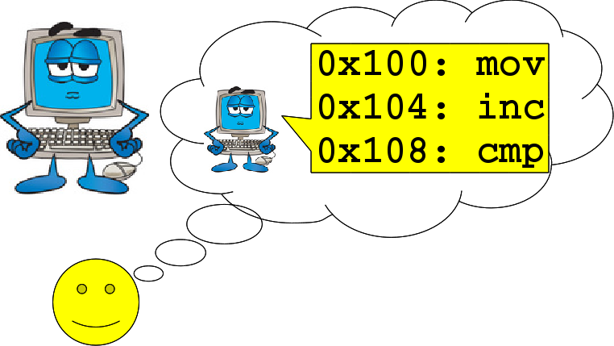
One user's view of a computer
Computer spends all of its time doing instructions for my program

Slide 7
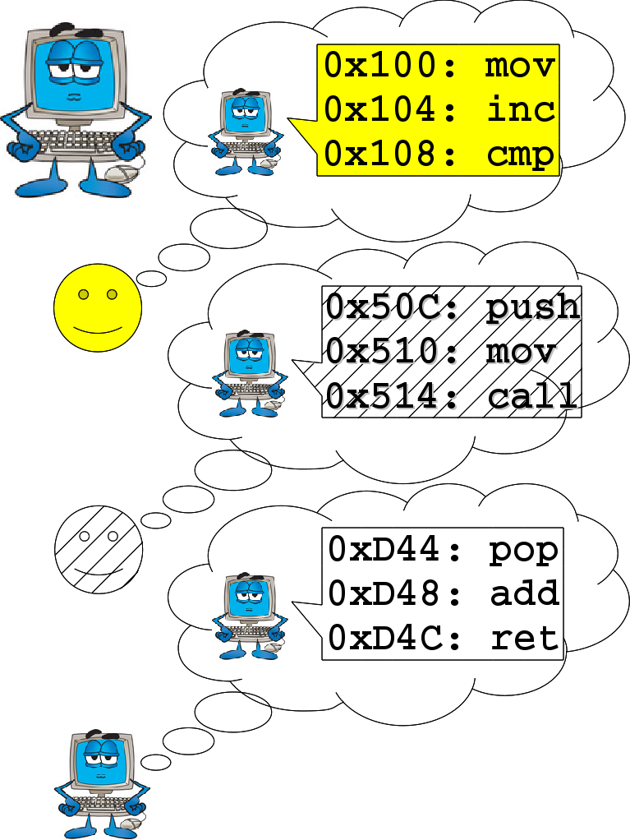
Of course computers run multiple processes
More than one user
More than one process per user
OS also handles hardware events (key press, network traffic, timer) and its own maintenance (disk defragmenting)

Slide 8
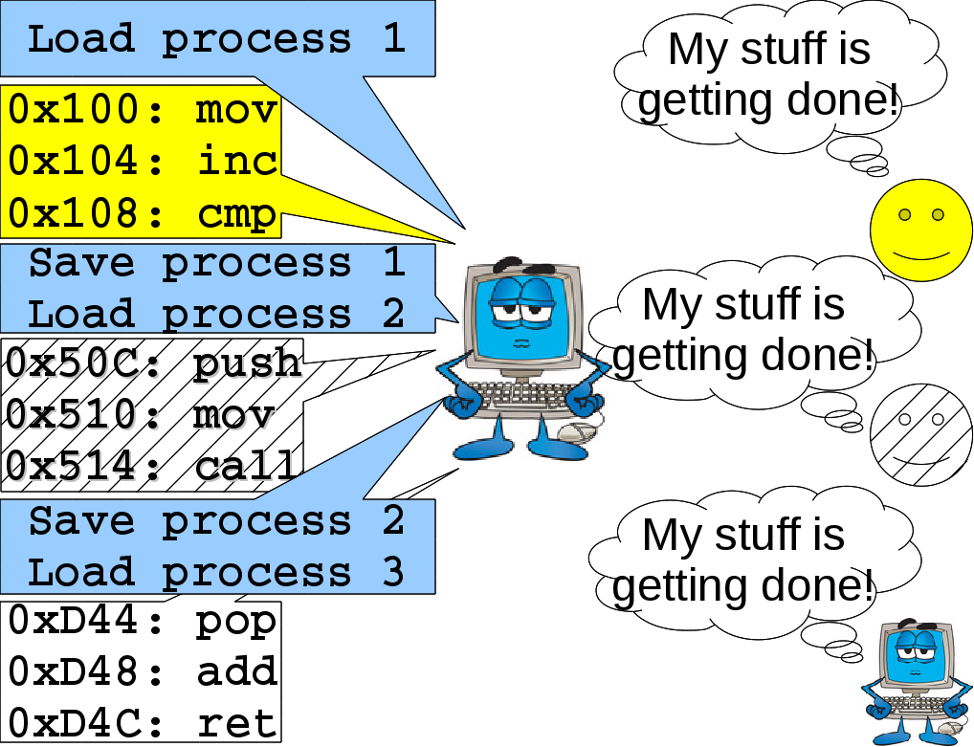
How computers do it

Slide 9
What's in a context switch?
What's has to be loaded and saved?
  Registers
  Page table
  Signal vector (more about that next week)
  CPU and memory usage stats
  List of open files
  etc.
Doing a jmp to your own address or a call to your own function handled by a process without outside help.
Exceptions, however needed to:
  Switch between processes
  Access system resources

Slide 10
4 types of exceptions
Class | Cause | Synchronicity | Return behavior
Interrupt | Signal from hardware | Async | Next instruct
Trap | Intentional call | Sync | Next instruct
Fault | Potentially recoverable error | Sync | Maybe next instruct
Abort | Unrecoverable error | Sync | Never returns

Slide 11
Interrupts
Hardware says “I don't care which ordinary user's process you're running, attend to me now! (or at least soon)”
  A key is pressed by the user
  A packet comes over the network
  Computer's timer goes off

Slide 12
Doing an interrupt
An interrupt (identified by an integer) fires
Save state of running process
  Common to push registers on stack
Go to interrupt table (aka vector table): array of pointers to code to handle interrupts
Get address from array
Go to that address
Do code
Re-load state of running process

Slide 13
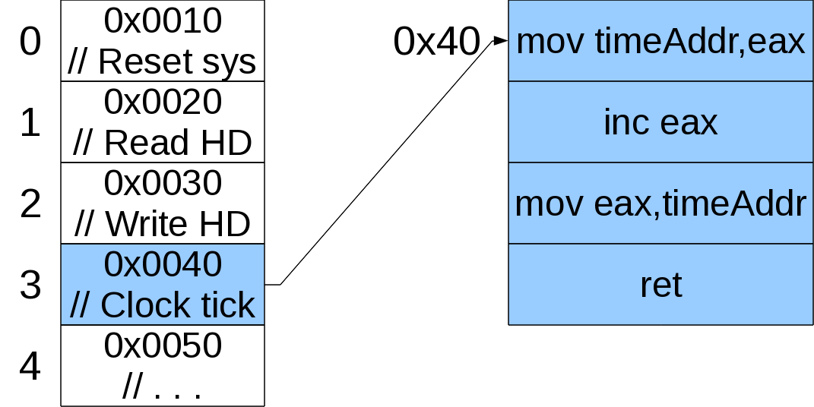
Interrupt table or vector table
Array of pointers to functions to handle specific interrupts

Slide 14
“IBM PC” i386 Interrupt Table (1)
ROM BIOS by IBM (Microsoft?) circa 1981
Now standardized and written by:
  American Megatrends Inc
  Micro Firmware
  Phoenix Technologies
00h CPU: Executed after an attempt to divide by zero or when the quotient does not fit in the destination
01h CPU: Executed after every instruction while the trace flag is set
02h CPU: NMI, used e.g. by POST for memory errors
03h CPU: The lowest non-reserved interrupt, it is used exclusively for debugging, and the ​INT 03​ handler is always implemented by a debugging program

Slide 15
“IBM PC” i386 Interrupt Table (2)
04h CPU: Numeric Overflow. Usually caused by the ​INTO​ instruction when the overflow flag is set.
05h Executed when Shift-Print screen is pressed, as well as when the ​BOUND​ instruction detects a bound failure.
06h CPU: Called when the Undefined Opcode (invalid instruction) exception occurs. Usually installed by the operating system.
07h CPU: Called when an attempt was made to execute a floating-point instruction and no numeric coprocessor was available.
08h IRQ0: Implemented by the system timing component; called 18.2 times per second (once every 55 ms) by the PIC.
09h IRQ1: Called after every key press and release (as well as during the time when a key is being held)

Slide 16
“IBM PC” i386 Interrupt Table (3)
0Ah Reserved for OS?
0Bh IRQ3: Called by serial ports 2 and 4 (COM2/4) when in need of attention
0Ch IRQ4: Called by serial ports 1 and 3 (COM1/3) when in need of attention
0Dh IRQ5: Called by hard disk controller (PC/XT) or 2nd parallel port LPT2 (AT) when in need of attention
0Eh IRQ6: Called by floppy disk controller when in need of attention
0Fh IRQ7: Called by 1st parallel port LPT1 (printer) when in need of attention
10h Video Services - installed by the BIOS or operating system; called by software programs
AH=00h: Set video mode;
AH=01h: Set Cursor shape
Etc.

Slide 17
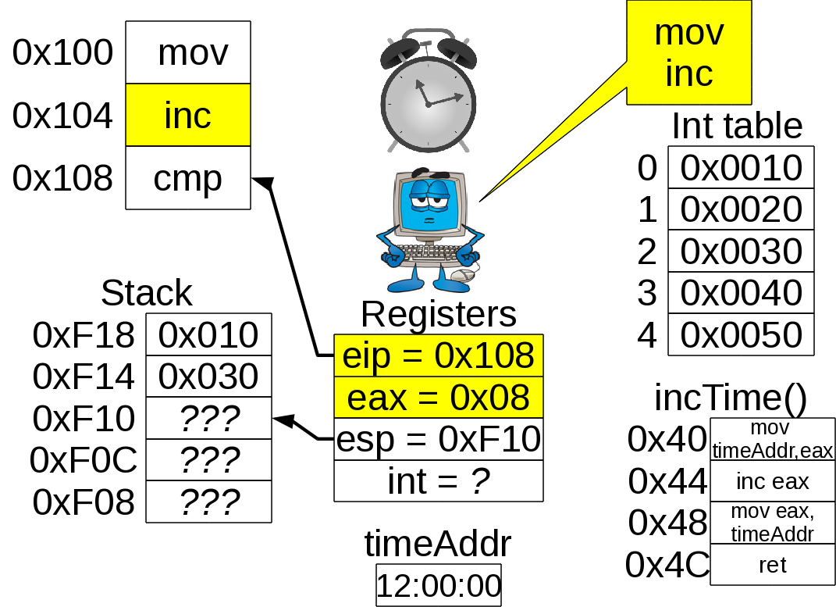
Example interrupt (1)

Slide 18
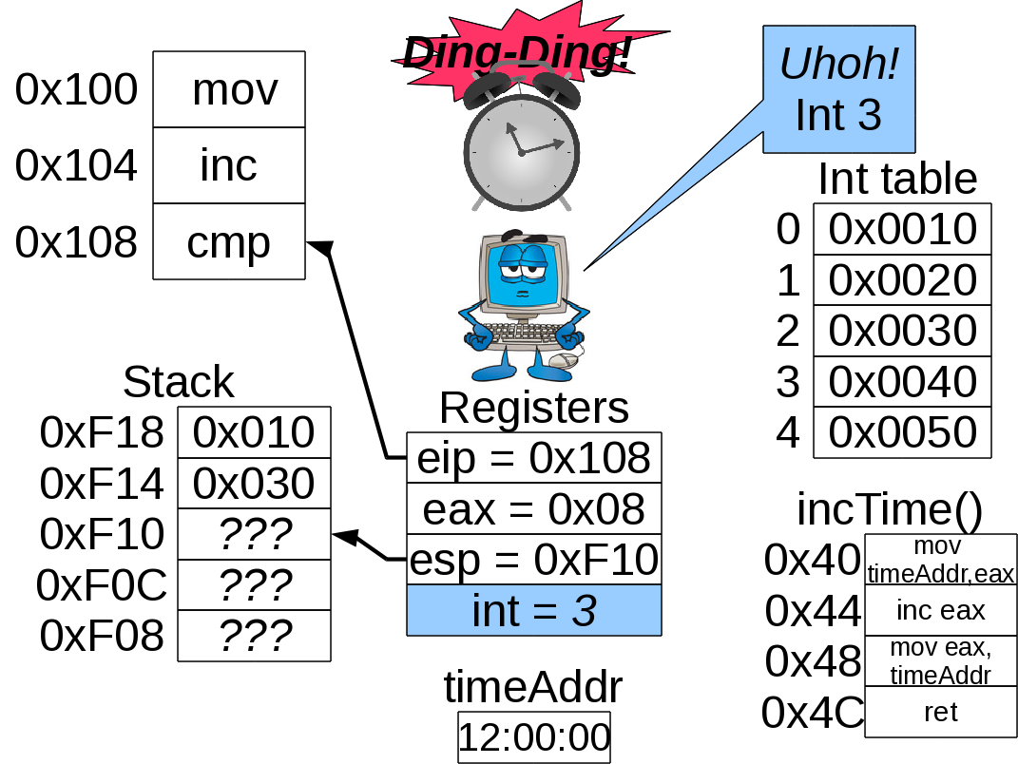
Example interrupt (2)

Slide 19
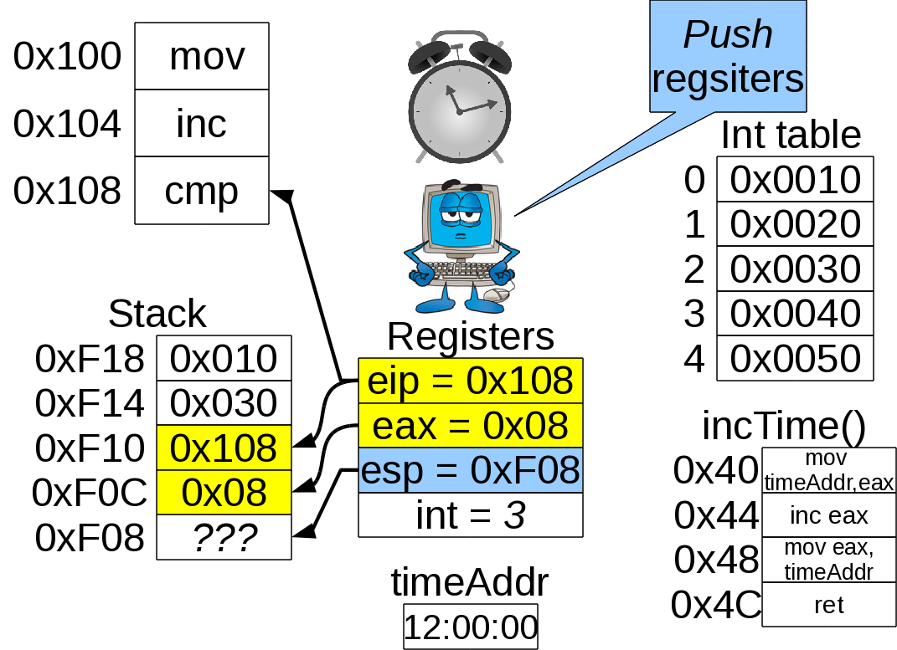
Example interrupt (3)

Slide 20
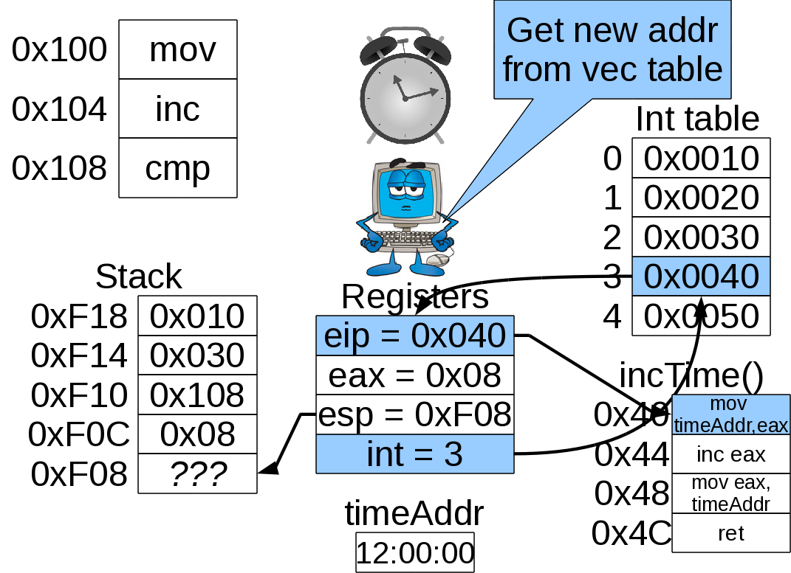
Example interrupt (4)

Slide 21
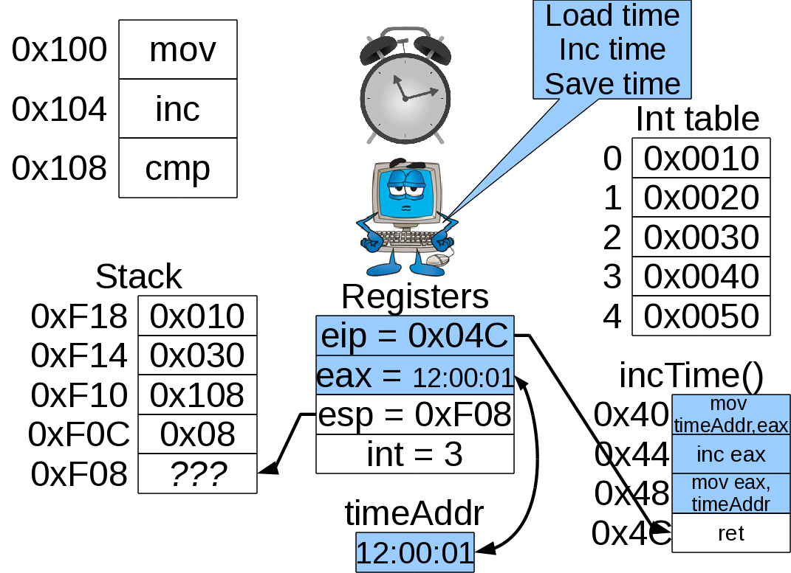
Example interrupt (5)

Slide 22
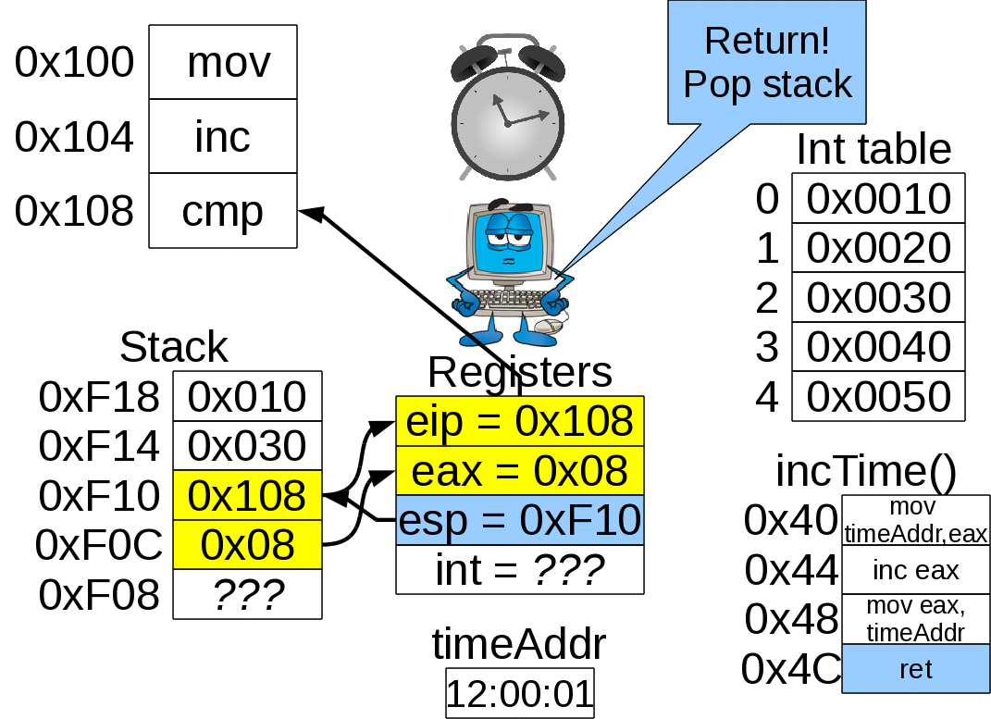
Example interrupt (6)

Slide 23
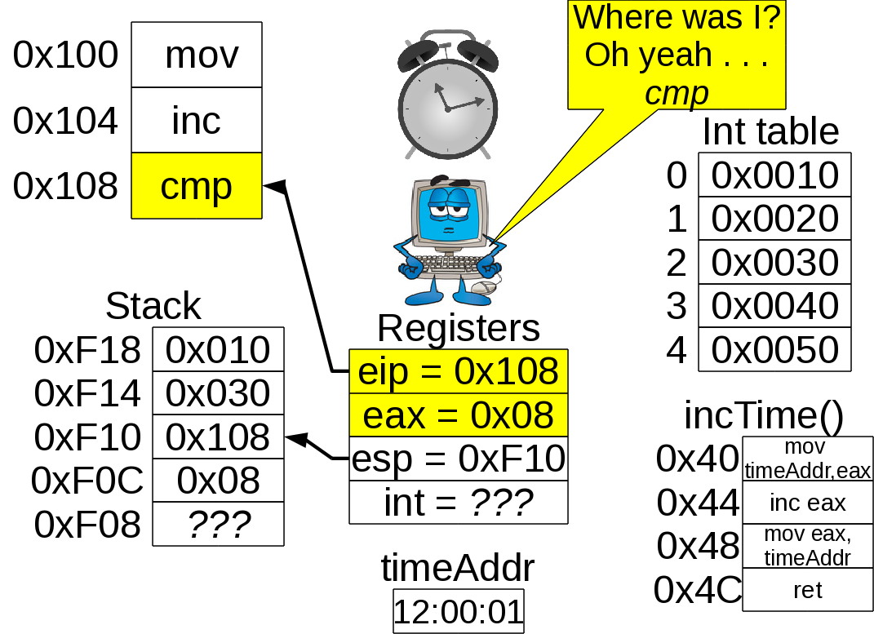
Example interrupt (7)

Slide 24
Your turn!
The vector table on the original IBM PC was writeable by any program.
It also has a timer.
You want to take some action every N seconds
Question 1: How would you do so without messing up system time?
Question 2: Is this an elegant solution?

Slide 25
Traps
Intentional exceptions (e.g. system calls)
  Linux uses int 0x80 for all system calls
$ gcc -static hiWorld.c -o hiWorld
$ objdump -d -j .text hiWorld > textSeg.asm
$ grep "int " textSeg.asm
Open up textSeg.asm and see interrupts:
8049109: 89 f1 mov %esi,%ecx
804910b: 89 fa mov %edi,%edx
804910d: b8 92 00 00 00 mov $0x92,%eax
8049112: cd 80 int $0x80
Question: If Linux always uses int 0x80 how does it know what service to perform?
  Hint: Look carefully at its preceding code

Slide 26
Traps, cont'd
Look in:
  /usr/include/sys/syscall.h, redirected to
  /usr/include/asm/unistd.h, finally to
  /usr/include/asm/unistd_32.h
There you'll see:
#define __NR_restart_syscall 0
#define __NR_exit 1
#define __NR_fork 2
#define __NR_read 3
#define __NR_write 4
#define __NR_open 5
#define __NR_close 6
#define __NR_waitpid 7
#define __NR_creat 8
. . . .

Slide 27
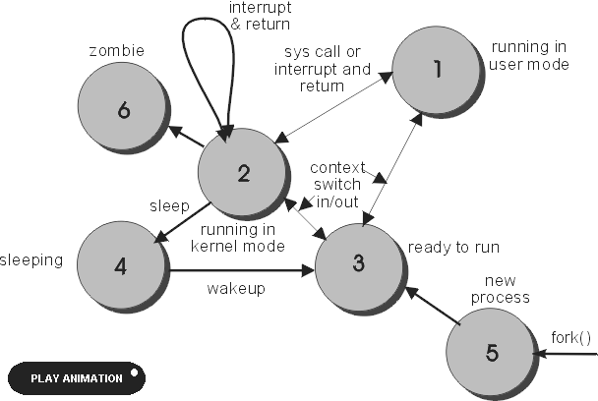
Doing a trap: same process in kernel mode

Slide 28
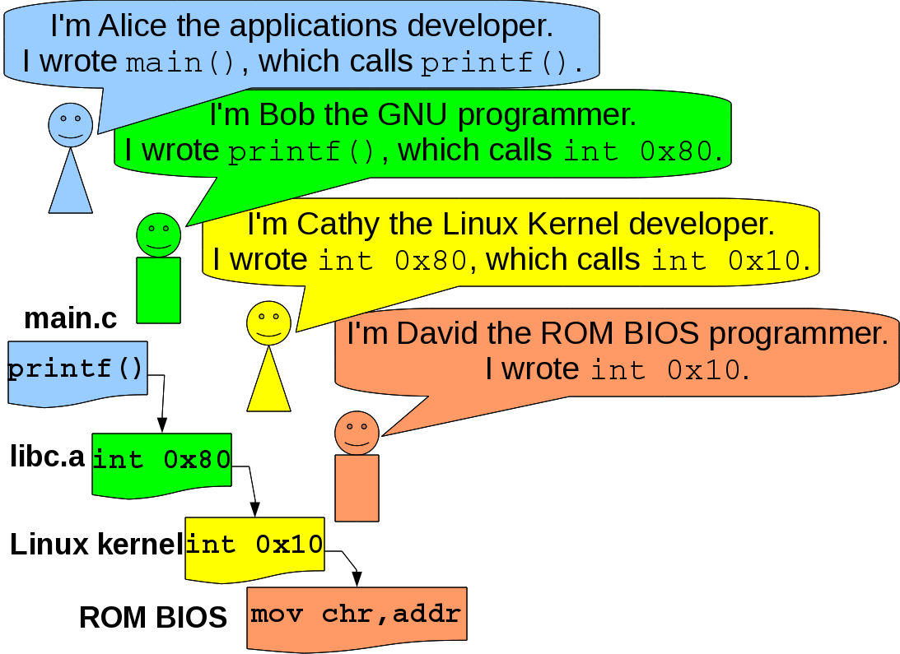
Following a system call

Slide 29
Fault
Waiting on some system-allocated resource:
  Example: memory (in a virtual memory environment):
int main()
{
int bigArray[5000];
bigArray[4999] = 4998;
// Page fault when not in memory
}

Slide 30
Abort
OS “You can't do that!”
  Writing to where you can't write to
  Reading from where you can't read from
int main()
{
int bigArray[5000];
bigArray[-400000] = 4998;
// Abort when addr not in page table
}

Slide 31
Your turn!
Can't compiler or linker tell beforehand whether an instruction will be a trap or abort and do something about it at compile or link time?

Slide 32
Yeah yeah, other than printf() what other system calls can I do?
Among the most powerful things you can do are:
  Make Brand New processes! (This lecture)
  Tell your processes how to behave when they receive signals! (Next lecture)

Slide 33
fork(), getpid() and getppid()
fork() makes a baby process that is an exact copy of a mama process
fork() returns type pid_t (usually an int):
  -1: “Too many processes, fool!”
  0: “I must be the baby”
  (positive number): “I'm the mama and I got my baby's number”
Question: How does a baby know its number?
  Answer: getpid()
Question: How does a baby know its mama?
  Answer: getppid()

Slide 34
fork() example 1
#include <stdlib.h>
#include <stdio.h>
int main ()
{
int x = 1;
pid_t pid = fork();
if (pid == 0)
printf("Child has x = %d\n",++x);
else
printf("Parent has x = %d\n",--x);
printf("Bye from process %d with x = %d\n",
getpid(),x
);
return(0);
}

Slide 35
fork() example 2
// How many processes result from this?
#include <stdlib.h>
#include <stdio.h>
int main ()
{
puts("L0");
fork();
puts("L1");
fork();
printf("Bye from process %d\n",getpid());
return(0);
}

Slide 36
Your turn!
OS's are cheap and lazy. If they can get away with letting the mama and baby process share a segment, they will.
Which segments can mama and baby share?
  .text
  .rodata
  .data and .bss
  Heap
  Dynamic libraries
  Stack

Slide 37
Your turn, again!
Write programs to prove that the mama and baby have distinct:
  .data segments
  .bss segments
  Stacks
  Heaps

Slide 38
exit(), a way to end the process
exit(EXIT_SUCCESS)
  Everything went fine
  Integer value 0
exit(EXIT_FAILURE)
  Uhoh! An error occurred.
  Integer value 1
Also doable as return(EXIT_SUCCESS) or return(EXIT_FAILURE) within main()

Slide 39
atexit(): A way to do things after main() ends
#include <stdlib.h>
#include <stdio.h>
void cleanup ()
{
printf("Cleaning up after %d\n",getpid());
}
int main ()
{
atexit(cleanup);
puts("Forking");
fork();
printf("Process %d's main() finished.\n",getpid());
return(0);
}

Slide 40
execl(): same process, different program
Same process running different program:
#include <stdlib.h>
#include <stdio.h>
#include <string.h>
#include <unistd.h>
int main ()
{
char line[100];
printf("What program do you want to run? ");
fgets(line,100,stdin);
char* cPtr = strchr(line,'\n');
if (cPtr != NULL)
*cPtr = '\0';
execl(line,line,NULL);
return(EXIT_SUCCESS);
}

Slide 41
Your turn!
fork() and execl() together:
Write a program where the mama process asks for a program to run, and the baby process runs it.

Slide 42
“But wait! There's more . . .”
There are several versions of exec*().
All do the same thing with different parameters:
  E.g. execv() lets you pass a NULL-terminated array instead of listing all arguments in command:
  Do $ man execl for more details
#include <unistd.h>
extern char **environ;
int execl(const char *path, const char *arg, ...);
int execlp(const char *file, const char *arg, ...);
int execle(const char *path, const char *arg, ...,
char * const envp[]);
int execv(const char *path, char *const argv[]);
int execvp(const char *file, char *const argv[]);
int execvpe(const char *file, char *const argv[],
char *const envp[]);

Slide 43

Almost a shell!
We have to tell the mama process to wait for the baby process
pid_t wait(int* statusIntPtr)
  How fortuitous!
  Make mama wait until some baby finishes
  Return the process id of the baby that finishes
  Sets pointed-to address equal to an integer that encodes exit() integer and if it exited properly
    WIFEXITED(statusInt): non-0 means “okay”, 0 means “error”
    WEXITSTATUS(statusInt): Lowest byte of integer returned by exit().

Slide 44
Your turn again!
Revise our almost-shell program so that the mama wait()s until for baby to finish.

Slide 45
Waiting for the right baby
wait() waits until some baby (the first baby) finishes
Want to wait for a specific baby?
  pid_t waitpid(pid_t childId, int* statusIntPtr, 0)
Want not to wait if no baby has finished?
  pid_t waitpid(pid_t childId, int* statusIntPtr, WNOHANG)
Want to wait for any old baby just like wait()?
  pid_t waitpid(-1, int* statusIntPtr, 0)

Slide 46
waitpid() example, pg 1
/* Setup */
#include <stdlib.h>
#include <stdio.h>
#include <unistd.h>
#include <sys/types.h>
#include <sys/wait.h>
const int N = 16;
int main ()
{
pid_t pid[N];
int i;
int status;

Slide 47
waitpid() example, pg 2
/* Making babies
How many second does the FIRST baby wait?
How many second does the LAST baby wait?
*/
for (i = 0; i < N; i++)
if ((pid[i] = fork()) == 0)
{
/* Child case */
sleep(N-i);
return(100+i);
}

Slide 48
waitpid() example, pg 3
/* waiting for babies (babysitting?) */
for (i = 0; i < N; i++)
{
pid_t childPid = waitpid(pid[i],&status,0);
if (WIFEXITED(child_status))
printf("Child %d ended with status %d\n",
childPid,WEXITSTATUS(status)
);
else
printf("Child %d ended abnormally\n",
childPid);
}
return(EXIT_SUCCESS);
}

Slide 49

Child neglect
Mama fork()s a baby
The baby does its job and finishes
Baby takes no CPU time (it's finished) but there is still an entry in process table (so mama can get return status, etc.)
But mama ignores finished baby

Slide 50

Baby becomes a ZOMBIE!

Slide 51
Zombie survival guide
A finished process with an entry in process table is “not-quite” dead. It's a zombie!
The not-so-bad:
  Zombies take no CPU time (they're finished)
The pretty-bad:
  Zombies do take System memory (in process table)
  One zombie? No big deal.
  An army of zombies? System starts running vvvveeerrrryyyy sssslllloooowwwwllllyyyy
  Might have to reboot system (Is this a problem with any OS you know? ;)

Slide 52
zombie_maker.c, page 1
#include <stdio.h>
#include <stdlib.h>
#include <unistd.h>
#include <sys/types.h>
#include <sys/wait.h>
int main ()
{
int child_status;
if (fork() == 0)
{
printf("HC: hello from child %d\n",getpid());
return(50);
}

Slide 53
zombie_maker.c, page 2
else
{
printf("HP: hello from parent\n"
"In another shell say 'ps aux'\n"
"Look for '<defunct>'.\n"
);
sleep(20);
wait(&child_status);
printf("CT: child has terminated and has given us %d\n",
WEXITSTATUS(child_status)
);
}
printf("Bye\n");
return(EXIT_SUCCESS);
}

Slide 54
Next time: Signals!

